Slide 1
Chapter 6
The Skeletal System: Bone Tissue

Slide 2
INTRODUCTION
Bone is made up of several different tissues working together: bone, cartilage, dense connective tissue, epithelium, various blood forming tissues, adipose tissue, and nervous tissue.
Each individual bone is an organ; the bones, along with their cartilages, make up the skeletal system.

Slide 3
Functions of Bone
Supporting & protecting soft tissues
Attachment site for muscles making movement possible
Storage of the minerals, calcium & phosphate -- mineral homeostasis
Blood cell production occurs in red bone marrow (hemopoiesis)
Energy storage in yellow bone marrow

Slide 4
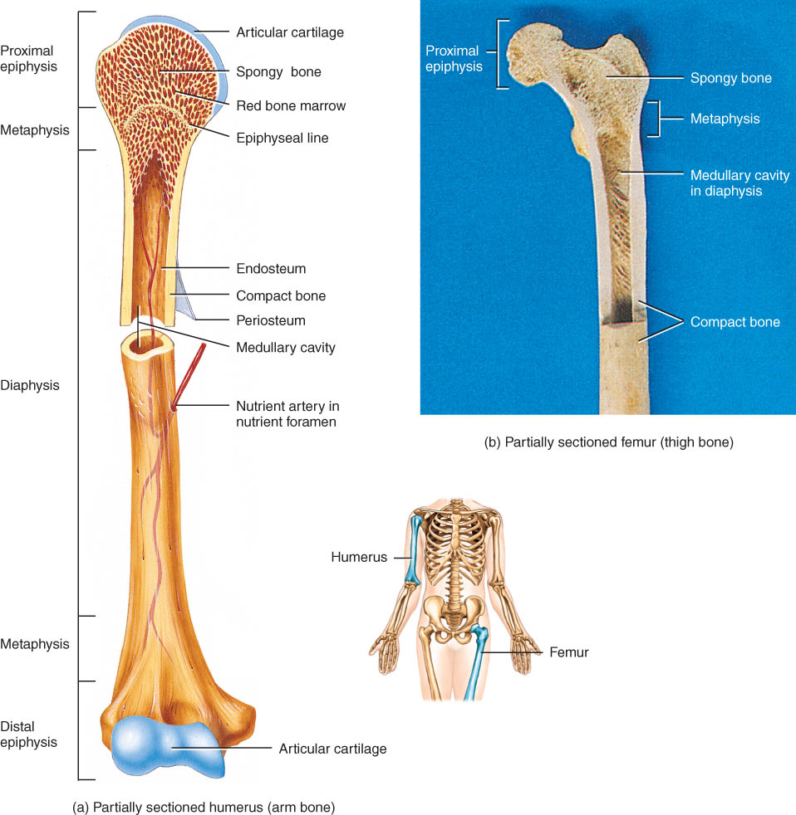
Anatomy of a Long Bone
diaphysis = shaft
epiphysis = one end
metaphyses - area between diaphysis and epiphysis and include the epiphyseal plate in growing bones.
Endosteum = lining of marrow cavity
Periosteum = tough membrane covering bone but not the cartilage
Articular cartilage over joint surfaces acts as friction reducer & shock absorber
Medullary cavity = marrow cavity

Slide 5
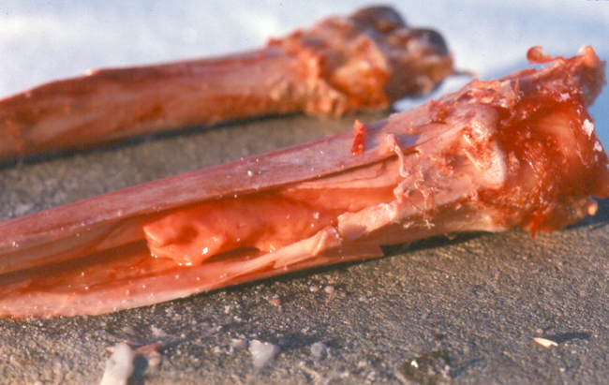
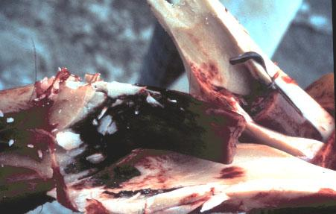
Changes in Bone Marrow
Bone marrow in healthy individual
Bone marrow in unhealthy individual
Marrow reconversion – changing of bone marrow from yellow to red
Reasons:
Increased demand for red blood cells (e.g. blood loss)
Physiologic stress – high athletic activity
High altitude

Slide 6
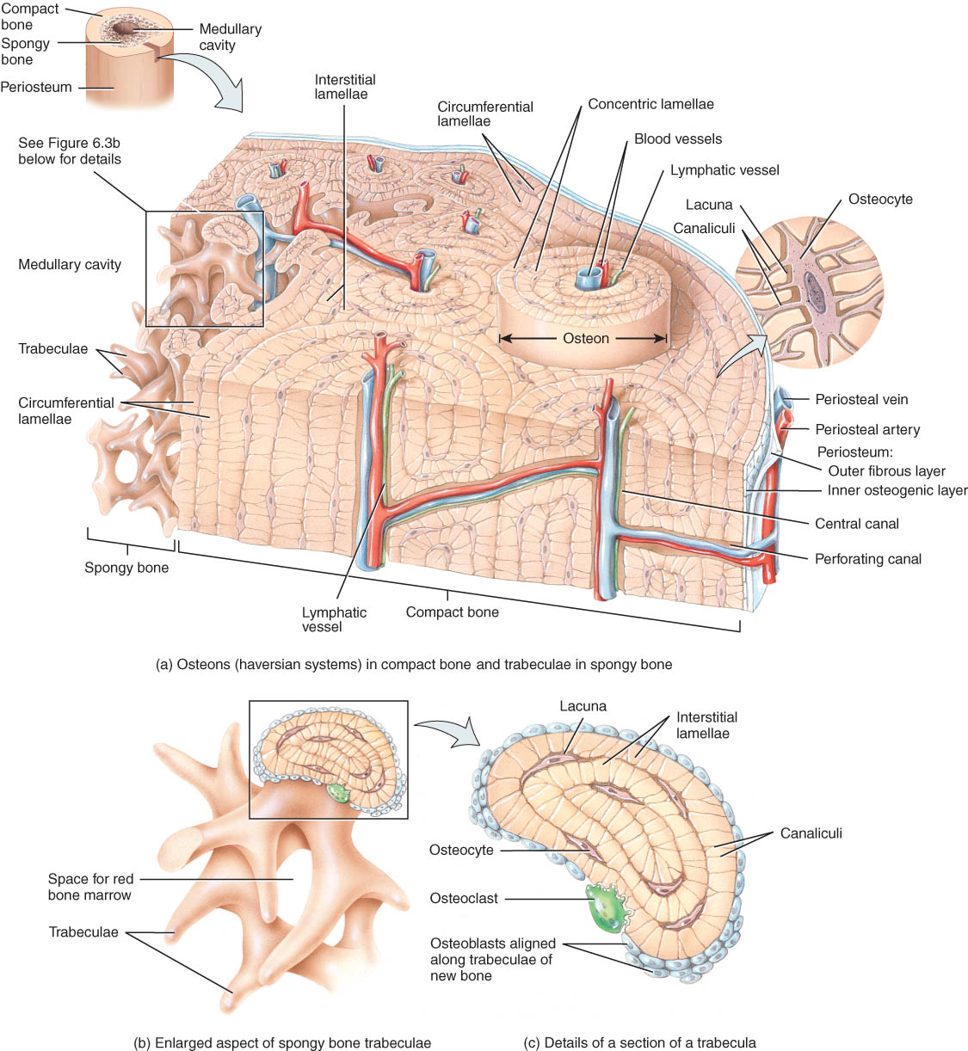
Histology of Bone
A type of connective tissue as seen by widely spaced cells separated by matrix
4 types of cells in bone tissue

Slide 7
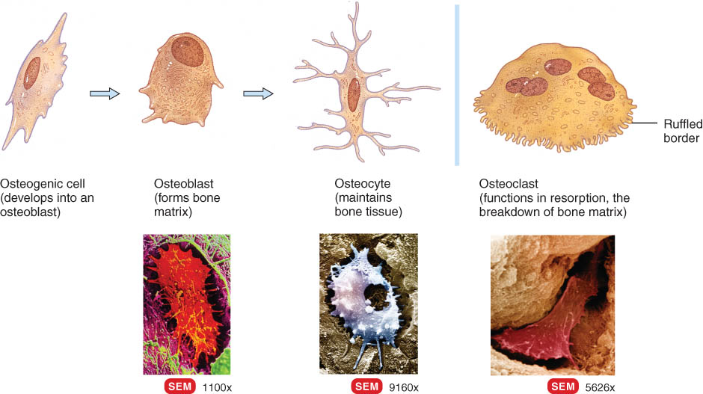
Bone Cells
Osteoprogenitor/osteogenic cells --
undifferentiated cells
can divide to replace themselves & can become osteoblasts
found in inner layer of periosteum and endosteum
Osteoblasts--form matrix & collagen fibers but can’t divide
Osteocytes ---mature cells that no longer secrete matrix
Osteoclasts---- huge cells from fused monocytes (WBC)
function in bone resorption at surfaces such as endosteum

Slide 8
Matrix of Bone
Inorganic mineral salts provide bone’s hardness
hydroxyapatite (calcium phosphate and calcium hydroxide) & calcium carbonate
Organic collagen fibers provide bone’s flexibility
their tensile strength resists being stretched or torn
remove minerals with acid & rubbery structure results
Bone is not completely solid since it has small spaces for vessels and red bone marrow
spongy bone has many such spaces
compact bone has very few such spaces

Slide 9
Compact or Dense Bone
Looks like solid hard layer of bone
Makes up the shaft of long bones and the external layer of all bones
Resists stresses produced by weight and movement

Slide 10
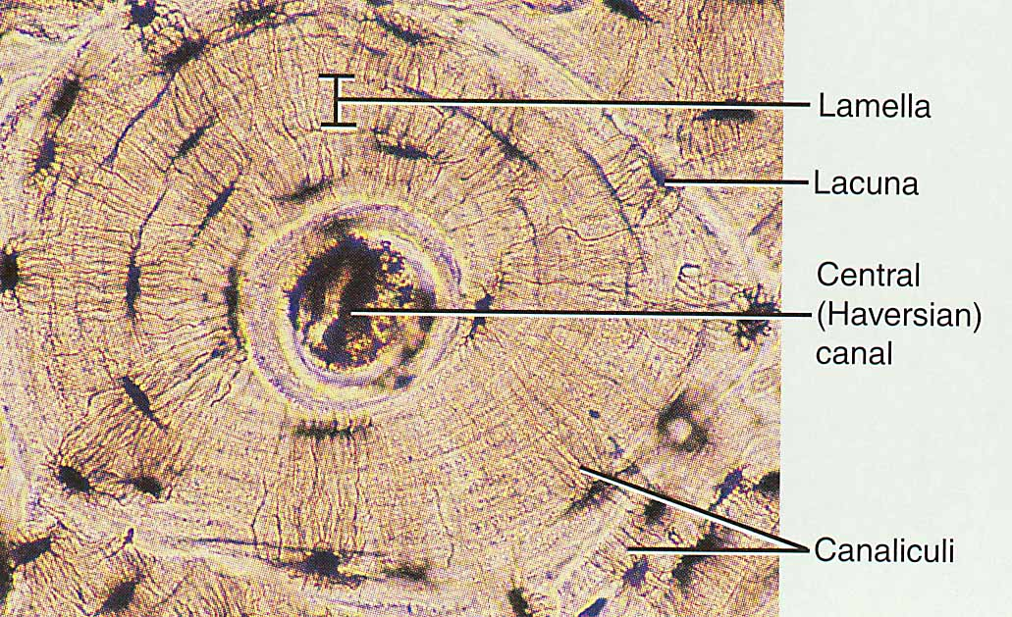
Histology of Compact Bone
Osteon is concentric rings (lamellae) of calcified matrix surrounding a vertically oriented blood vessel
Osteocytes are found in spaces called lacunae
Osteocytes communicate through canaliculi filled with extracellular fluid that connect one cell to the next cell

Slide 11
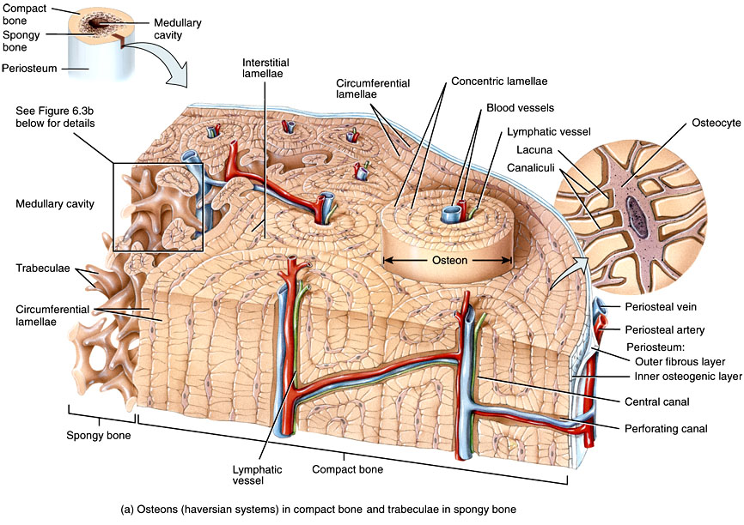
Histology of Compact Bone
Haversian canal
Volkmann’s canals

Slide 12
Spongy Bone
Latticework of thin plates of bone called trabeculae oriented along lines of stress
Spaces in between these struts are filled with red marrow where blood cells develop
Found in ends of long bones and inside flat bones such as the hipbones, sternum, sides of skull, and ribs.
No true Osteons.

Slide 13
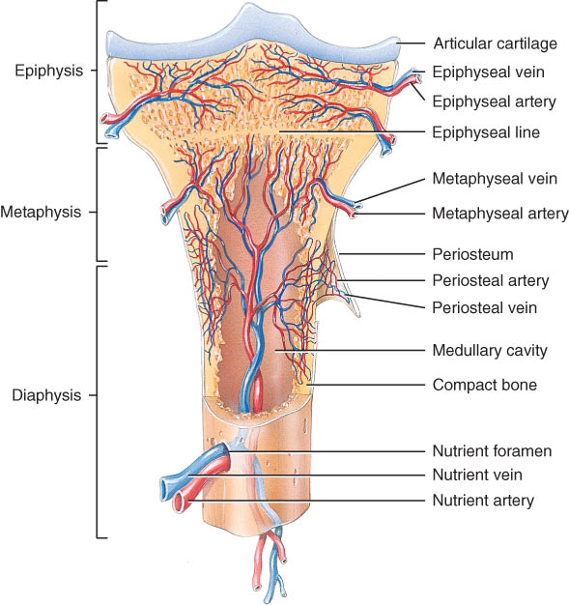
Blood and Nerve Supply of Bone
Periosteal arteries
supply periosteum
Nutrient arteries
enter through nutrient foramen
supplies compact bone of diaphysis & red marrow
Metaphyseal & epiphyseal arterie.
supply red marrow & bone tissue of epiphyses

Slide 14
BONE FORMATION
All embryonic connective tissue begins as mesenchyme.
Bone formation is termed osteogenesis
Two types of ossification occur.
Intramembranous ossification is the formation of bone directly from or within fibrous connective tissue membranes.
Endochondrial ossification is the formation of bone from hyaline cartilage models.

Slide 15
Intramembranous Ossification
Intramembranous ossification forms the flat bones of the skull and the mandible.
Steps:
An ossification center forms from mesenchymal cells as they convert to osteoblasts and lay down osteoid matrix.
The matrix surrounds the cell and then calcifies as the osteoblast becomes an osteocyte.
The calcifying matrix centers join to form bridges of trabeculae that constitute spongy bone with red marrow between.
On the periphery the mesenchyme condenses and develops into the periosteum.

Slide 16
Endochondral Ossification
Endochondral ossification involves replacement of a hyaline cartilage model of the skeleton by bone. This process forms all bones except some bones of the skull and clavicles
Endochondral ossification begins late in 2nd month of human development and continues until early adulthood (i.e. when the growth plate closes).

Slide 17
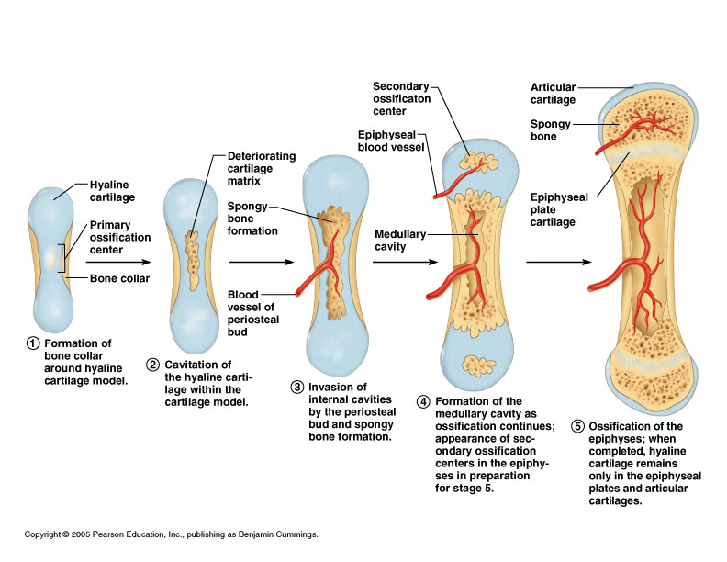
Stage 1 in Endochondral Ossification
A wide band of bone (bone collar) begins to form around the diaphysis of the hyaline cartilage model of the bone.
This will lead to the formation of the primary ossification center where bone will first start to form.

Slide 18
Stage 2 in Endochondral Ossification
Because hyaline cartilage is avascular, the bone collar prevents nutrients from being passed to chondrocytes in the center and the cartilage matrix deteriorates forming a space (cavitation).
Figure 6.10

Slide 19
Stage 3 in Endochondral Ossification
Blood vessels penetrate the bone collar and enter the central cavity.
With the addition of blood vessels, osteoblasts also enter the cavity and start forming spongy bone.
Figure 6.10

Slide 20
Stage 4 in Endochondral Ossification
The formation of bone from cartilage (ossification) continues with spongy bone being converted into compact bone.
A distinct medullary cavity forms.
Other blood vessels penetrate the epiphysis of the cartilage model, again bringing osteoblasts with them, allowing for secondary ossification centers to form at both end of the bone.

Slide 21
Stage 5 in Endochondral Ossification
The process continues until the only remaining cartilage is the epiphyseal plate (growth plate).
Eventually, due to increased estrogen levels, the epiphyseal plate will close and growth in length will stop.

Slide 22
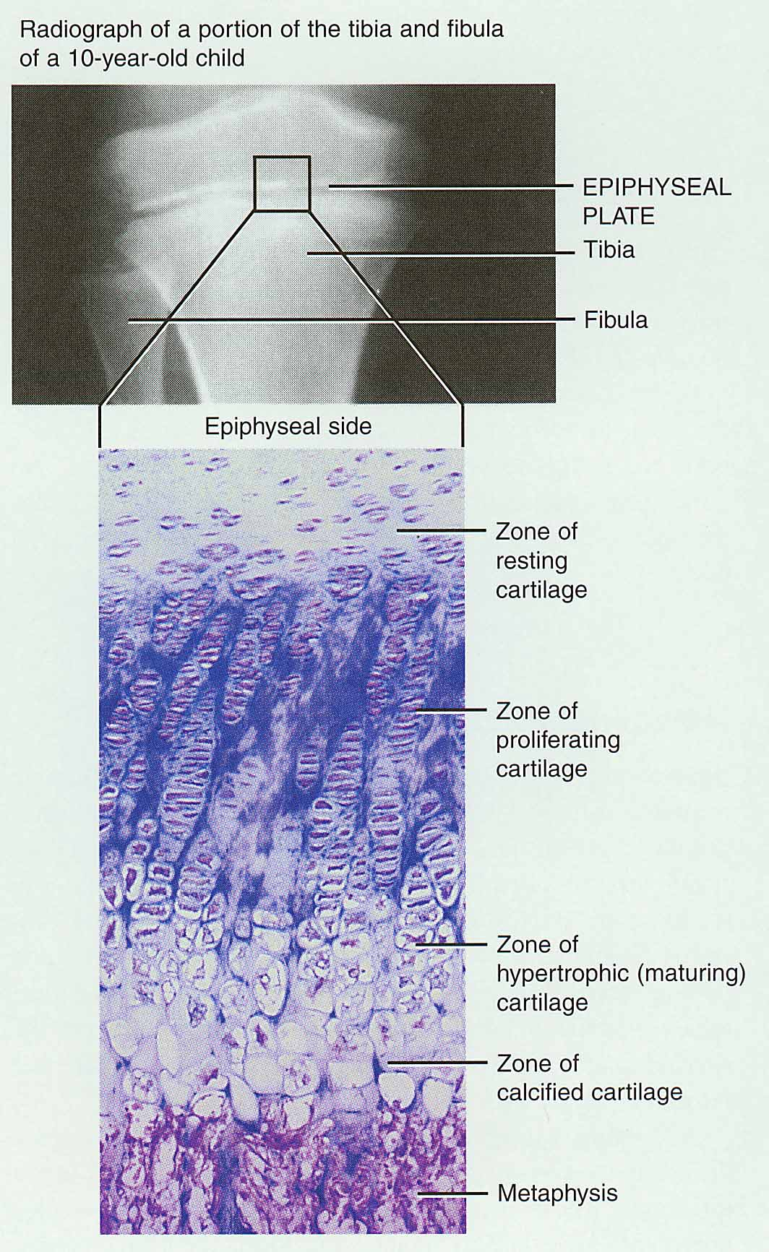
Bone Growth in Length
Epiphyseal plate or cartilage growth plate
cartilage cells are produced by mitosis on epiphyseal side of plate
cartilage cells are destroyed and replaced by bone on diaphyseal side of plate
Between ages 18 to 25, epiphyseal plates close due to elevated estrogen levels.

Slide 23
Zones of Growth in Epiphyseal Plate What is happening at each one?
Zone of resting cartilage
Zone of proliferating cartilage
Zone of hypertrophic cartilage
Zone of calcified cartilage

Slide 24
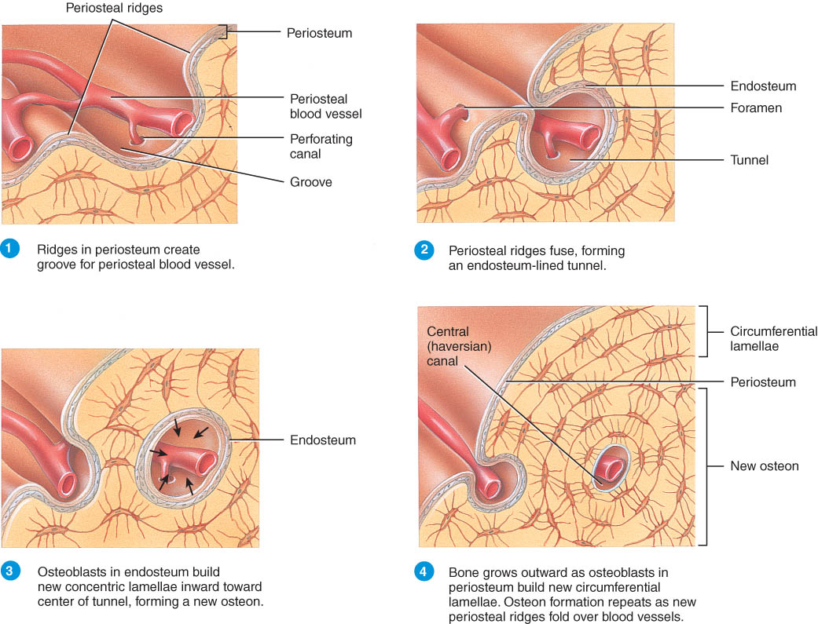
Bone Growth in Width
Appositional growth = growth in width
Appositional growth occurs at the bone’s surface
How does that happen?
Periosteal cells differentiate into osteoblasts and form bony ridges and then a tunnel around periosteal blood vessel.
Concentric lamellae fill in the tunnel to form an osteon.

Slide 25
Factors Affecting Bone Growth
Nutrition
adequate levels of minerals and vitamins
calcium and phosphorus, vitamin C (collagen formation)
Sufficient levels of specific hormones
during childhood need insulinlike growth factor
promotes cell division at epiphyseal plate
need hGH (growth), thyroid (T3 &T4) and insulin
sex steroids at puberty
What role do they play?

Slide 26
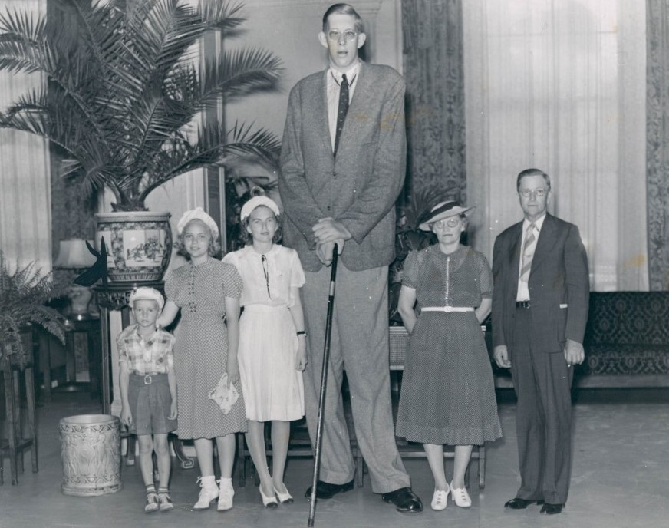
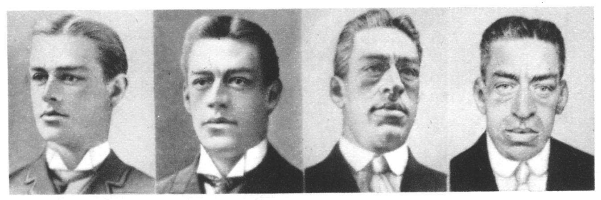
Hormonal Abnormalities
Oversecretion of hGH can produces significant effects:
Gigantism
Acromegaly
Both men or women that lack estrogen receptors on cells grow taller than normal
estrogen is responsible for closure of growth plate

Slide 27
Bone Remodeling
Remodeling is the ongoing replacement of old bone tissue by new bone tissue.
Old bone is constantly destroyed by osteoclasts as they carve out small tunnels, and new bone is constructed by osteoblasts as they form osteons and spongy bone.
Continual redistribution of bone matrix along lines of mechanical stress
distal femur is fully remodeled every 4 months

Slide 28
Fractures
Named for shape or position of fracture line
Common types of fracture
greenstick -- partial fracture
impacted -- one side of fracture driven into the interior of other side
closed -- no break in skin
open fracture --skin broken
comminuted -- broken ends of bones are fragmented
Pott’s -- distal fibular fracture
Colles’s -- distal radial fracture
stress fracture -- microscopic fissures from repeated strenuous activities

Slide 29
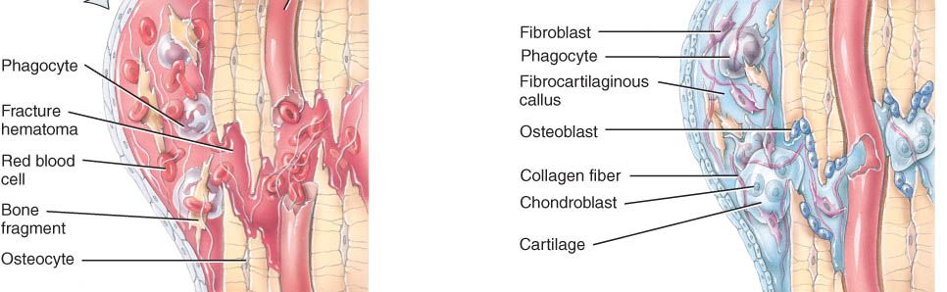
Repair of a Fracture
Formation of fracture hematoma
damaged blood vessels produce clot in 6-8 hours, bone cells die
inflammation brings in phagocytic cells for clean-up duty
Formation of fibrocartilagenous callus formation

Slide 30
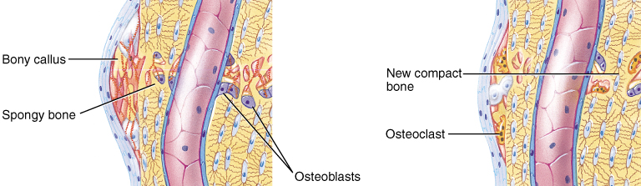
Repair of a Fracture
Formation of bony callus
lasts 3-4 months
Bone remodeling

Slide 31
Calcium Homeostasis & Bone Tissue
Skeleton is a reservoir of Calcium & Phosphate
Calcium ions involved with many body systems
nerve & muscle cell function
blood clotting
enzyme function in many biochemical reactions
The storage and release of calcium is primarily controlled by two hormones: calcitonin and parathyroid hormone.

Slide 32
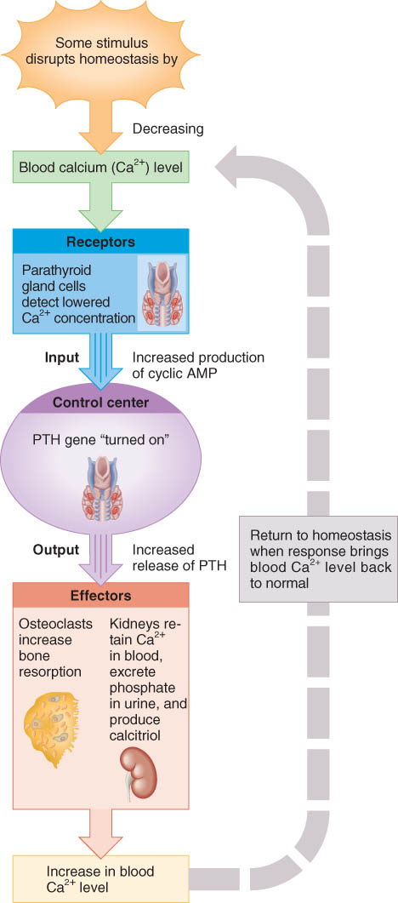
Hormonal Influences
Parathyroid hormone (PTH) is secreted if Ca²⁺ levels falls
osteoclast activity increased, kidney retains Ca²⁺ and produces calcitriol
Calcitonin hormone is secreted from thyroid if Ca²⁺ blood levels get too high
inhibits osteoclast activity
increases bone formation by osteoblasts

Slide 33
EXERCISE AND BONE TISSUE
Within limits, bone has the ability to alter its strength in response to mechanical stress by increasing deposition of mineral salts and production of collagen fibers.
Weight-bearing activities, such as walking or moderate weightlifting, help build and retain bone mass.

Slide 34
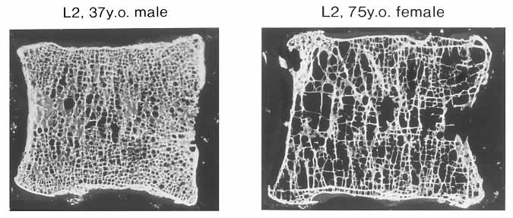
AGING AND BONE TISSUE
Of two principal effects of aging on bone, the first is demineralization which may result in osteoporosis.
rapid in women 40-45 as estrogens levels decrease
Estrogen reduces the number of osteoclasts, increases the activity of osteoblasts and speeds up the absorption of calcium
in males, begins after age 60
The second is a decreased rate of protein synthesis
decrease in collagen production
bone becomes brittle & susceptible to fracture

